Slide 1
DSE CLZG519 - Data Structures & Algorithm Design #06-07 : Graphs

Slide 2
Agenda
6.1 Terminology, Properties
6.2 Representation
6.3 DFS & Applications
6.4 BFS & Applications
2

Slide 3
#06.1 : Graphs - Terminology & Properties

Slide 4
What is a Graph
A graph is a pair (V, E), where
V is a set of nodes, called vertices
E is a collection of pairs of vertices, called edges
Example:
A vertex represents an airport and stores the three-letter airport code
An edge represents a flight route between two airports and stores the mileage of the route
849
PVD
1843
ORD
142
SFO
802
LGA
337
1743
1387
HNL
2555
1099
LAX
1233
DFW
1120
MIA

Slide 5
Edges
Edge is represented as either as an unordered pair / ordered pair depending on the graph
An edge could be directed / undirected.
1843
ORD
SFO
Edges are undirected.
G = (V, E)
V = {SFO, ORD, LAX}
E = { {SFO,ORD}, {ORD, LAX}, {SFO, LAX} } /
E = { (SFO,ORD), (ORD, LAX), (SFO, LAX) }
337
1743
LAX
SO 12A
RF 56T
ORD
Edges are directed.
G = (V, E)
V = {SFO, ORD, LAX}
E = { (SFO,ORD),(ORD, SFO), (ORD, LAX), (LAX, ORD), (SFO, LAX) }
SFO
ID 4U9
ID 4P3
SO 43X
LAX
Notes:
In mathematics, an unordered pair or pair set is a set of the form {a, b}, i.e. a set having two elements a and b with no particular relation between them, where {a, b} = {b, a}. In contrast, an ordered pair (a, b) has a as its first element and b as its second element, which means (a, b) ≠ (b, a).

Slide 6
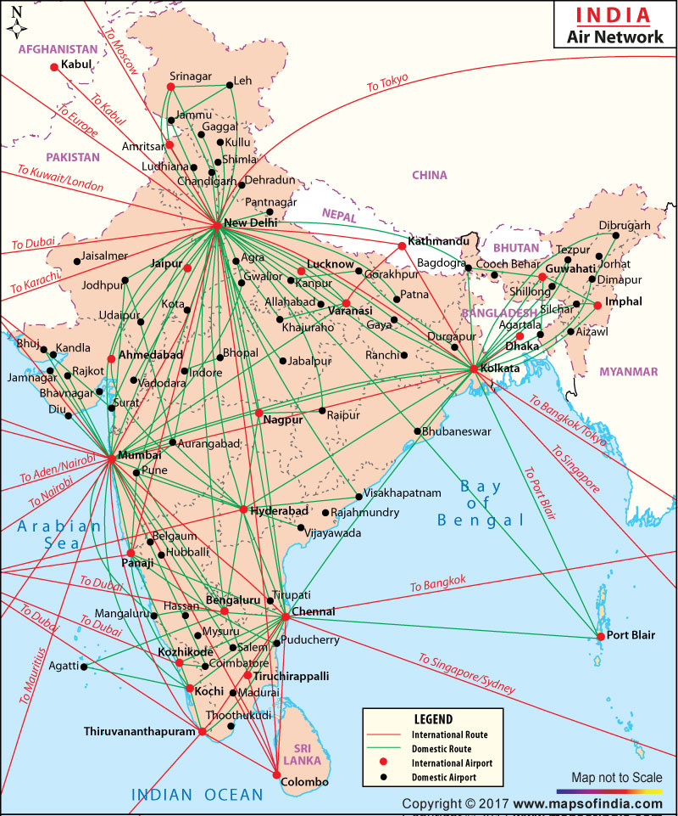
Applications
Electronic circuits
Printed circuit board
Integrated circuit
Transportation networks
Highway network
Flight network
Computer networks
Local area network
Internet
Web
Databases
Entity-relationship diagram
Source- Maps of India

Slide 7
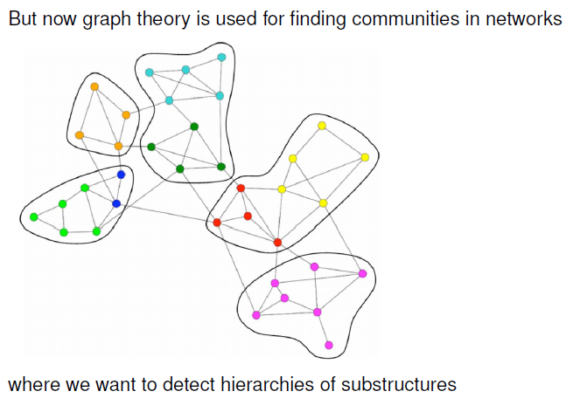

Slide 8
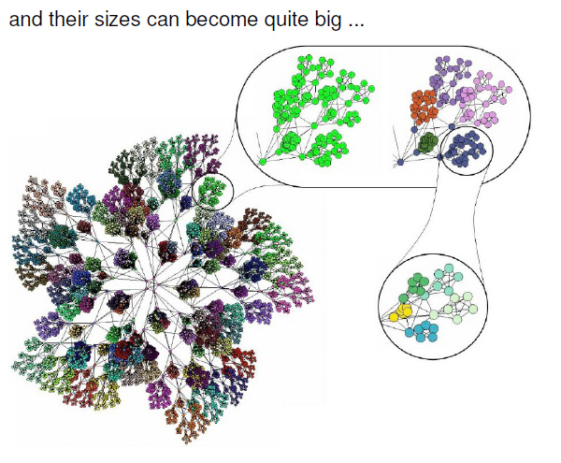

Slide 9
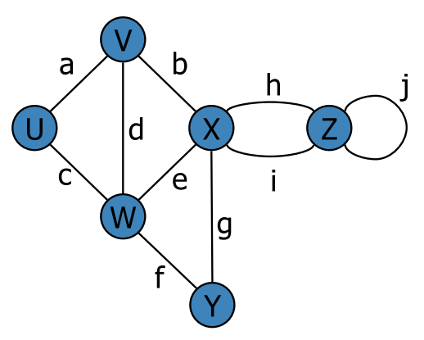
Terminology
End vertices (or endpoints) of an edge
U and V are the endpoints of a
Edges incident on a vertex
a, d, and b are incident on V
Adjacent vertices
U and V are adjacent
Degree of a vertex
X has degree 5
Parallel edges
h and i are parallel edges
Self-loop
j is a self-loop

Slide 10
Terminology
Path
sequence of alternating vertices and edges
begins with a vertex
ends with a vertex
each edge is preceded and followed by its endpoints
Simple path
path such that all its vertices and edges are distinct
Examples
P₁=(V,b,X,h,Z) is a simple path
V
a
b
P₁
d
U
X
Z
P₂
h
c
e
W
g
f
Y

Slide 11
Terminology
Path
sequence of alternating vertices and edges
begins with a vertex
ends with a vertex
each edge is preceded and followed by its endpoints
Simple path
path such that all its vertices and edges are distinct
Examples
P₁=(V,b,X,h,Z) is a simple path
P₂=(U,c,W,e,X,g,Y,f,W,d,V) is a path that is not simple
V
a
b
P₁
d
U
X
Z
P₂
h
c
e
W
g
f
Y

Slide 12
Terminology
Cycle
circular sequence of alternating vertices and edges
each edge is preceded and followed by its endpoints
Simple cycle
cycle such that all its vertices and edges are distinct
Examples
C₁=(V,b,X,g,Y,f,W,c,U,a) is a simple cycle
V
a
b
d
U
X
Z
C₂
h
e
C₁
c
W
g
f
Y

Slide 13
Terminology
Cycle
circular sequence of alternating vertices and edges
each edge is preceded and followed by its endpoints
Simple cycle
cycle such that all its vertices and edges are distinct
Examples
C₁=(V,b,X,g,Y,f,W,c,U,a) is a simple cycle
C₂=(U,c,W,e,X,g,Y,f,W,d,V,a) is a cycle that is not simple
V
a
b
d
U
X
Z
C₂
h
e
C₁
c
W
g
f
Y

Slide 14
Properties
Property 1
In an undirected graph with no self-loops and no multiple edges
Σ_{v} deg(v) = 2m
Proof: each edge is counted twice
Notation
n number of vertices
m number of edges
deg(v) degree of vertex v
Example
n = 4
m = 6
deg(v) = 3

Slide 15
Properties
Property 1
In an undirected graph with no self-loops and no multiple edges
Σ_{v} deg(v) = 2m
Proof: each edge is counted twice
Property 2
In an undirected graph with no self-loops and no multiple edges
m ≤ n (n − 1)/2
Proof: each vertex has degree at most (n − 1)
Notation
n number of vertices
m number of edges
deg(v) degree of vertex v
Example
n = 4
m = 6
deg(v) = 3

Slide 16
Properties
Property 1
In an undirected graph with no self-loops and no multiple edges
Σ_{v} deg(v) = 2m
Proof: each edge is counted twice
Property 2
In an undirected graph with no self-loops and no multiple edges
m ≤ n (n − 1)/2
Proof:
Each vertex has degree at most (n − 1)
Each edge is counted twice.
⇒ 2m ≤ n (n − 1)
⇒ m ≤ n (n − 1)/2
Notation
n number of vertices
m number of edges
deg(v) degree of vertex v
Example
n = 4
m = 6
deg(v) = 3

Slide 17
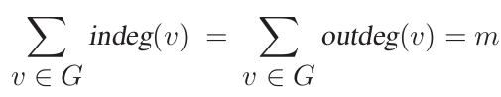
Properties
Property 3
If G is a directed graph with m edges, then
Proof: Each edge (u, v) contributes one unit to the out-degree of its origin u and one unit to the in-degree of its destination v.
Notation
n number of vertices
m number of edges
deg(v) degree of vertex v
a
Example
n = 4
m = 5
indeg(b) = 2
outdeg(b) = 1
b
c
d

Slide 18
Properties
Property 4
In an directed graph with no self-loops and no multiple edges
m ≤ n (n − 1)
Notation
n number of vertices
m number of edges
indeg(v), outdegree(v)
a
Example
n = 4
m = 5
indeg(b) = 2
outdeg(b) = 1
b
c
d

Slide 19
Properties
Property 2
In an undirected graph with no self-loops and no multiple edges
m ≤ n (n − 1)/2
Property 4
In an directed graph with no self-loops and no multiple edges
m ≤ n (n − 1)
A simple graph with n vertices has O(n²) edges
Notation
n number of vertices
m number of edges
indeg(v), outdegree(v)
a
Example
n = 4
m = 5
indeg(b) = 2
outdeg(b) = 1
b
c
d

Slide 20
#06.2 : Graphs - Representation

Slide 21
Operations on a Graph
Return the number, n, of vertices in G.
Return the number, m, of edges in G.
Return a set or list containing all n vertices in G.
Return a set or list containing all m edges in G.
Return some vertex, v, in G.
Return the degree, deg(v), of a given vertex, v, in G.
Return a set or list containing all the edges incident upon a given vertex, v, in G.
Return a set or list containing all the vertices adjacent to a given vertex, v, in G.
Return the two end vertices of an edge, e, in G; if e is directed, indicate which vertex is the origin of e and which is the destination of e.
Return whether two given vertices, v and w, are adjacent in G.
a
b
c
d

Slide 22
Operations on a Graph
Indicate whether a given edge, e, is directed in G.
Return the in-degree of v, inDegree(v).
Return a set or list containing all the incoming (or outgoing) edges incident upon a given vertex, v, in G.
Return a set or list containing all the vertices adjacent to a given vertex, v, along incoming (or outgoing) edges in G.
a
b
c
d

Slide 23
Operations on a Graph
Insert a new directed (or undirected) edge, e, between two given vertices, v and w, in G.
Insert a new (isolated) vertex, v, in G.
Remove a given edge, e, from G.
Remove a given vertex, v, and all its incident edges from G.
a
b
c
d

Slide 24
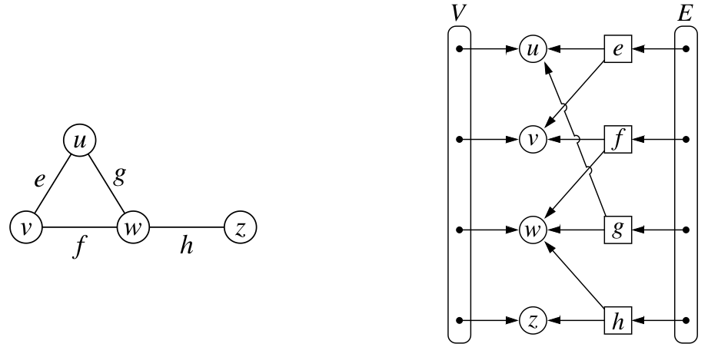
Edge List
Graph is represented as an unordered list of all edges [ primary rep ]
Vertex objects are stored in an unordered list V

Slide 25
Edge List
Graph is represented as an unordered list of all edges [ primary rep ]
Vertex objects are stored in an unordered list V
Note: Edge object refers to the two vertex objects that correspond to its endpoints,
Vertices do not refer to incident edges back

Slide 26
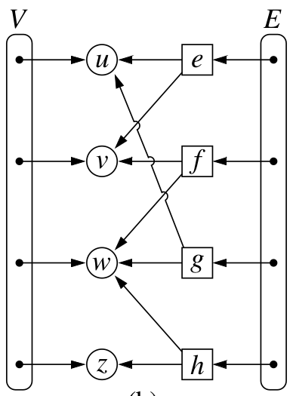
Edge List
For Efficient Manipulation of elements, Lists V, E are positional.
Individual elements can be manipulated by positions.
List could be DLL
Vertex object
access to element
reference to position in vertex sequence
Edge object
access to element
origin vertex object
destination vertex object
reference to position in edge sequence

Slide 27
Edge List - Ex -2
u
a
c
b
d
v
w
z
u
v
w
z
a
b
c
d

Slide 28
Edge List
One simple way to represent a graph is just a list, or array, of |E|which we call an edge list.
To represent an edge, we just have an array of two vertex numbers, that the edges are incident on.
If edges have weights, add a third element to the array.
[ [0,1], [0,6], [0,8], [1,4], [1,6], [1,9], [2,4], [2,6], [3,4], [3,5], [3,8], [4,5], [4,9], [7,8], [7,9] ]

Slide 29
Performance Review
n vertices, m edges
no parallel edges
no self-loops
Bounds are “big-Oh”
Edge List
Adjacency List
Adjacency Matrix
Space
n + m
n + m
n²
incidentEdges(v)
m
deg(v)
n
areAdjacent (v, w)
m
min(deg(v), deg(w))
1
insertVertex(o)
1
1
n²
insertEdge(v, w, o)
1
1
1
removeVertex(v)
m
deg(v)
n²
removeEdge(e)
1
1
1

Slide 30
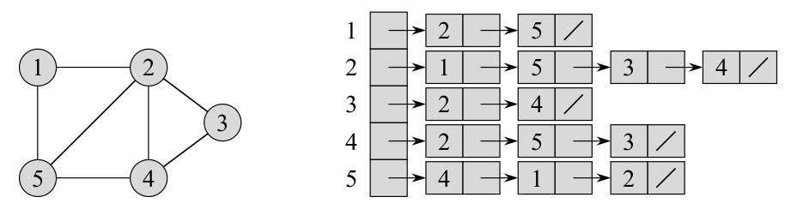
Adjacency List
The adjacency-list representation of a graph G(V, E) consists of an array Adj of |V| lists, one for each vertex in V .
For each u ε V , the adjacency list Adj[u] contains all the vertices such that there is an edge (u,v) ε E.

Slide 31
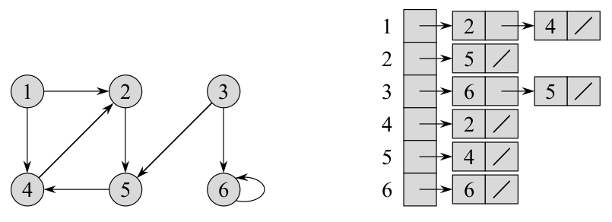
Adjacency List
The adjacency-list representation of a graph G(V, E) consists of an array Adj of |V| lists, one for each vertex in V .
For each u ε V , the adjacency list Adj[u] contains all the vertices such that there is an edge (u,v) ε E.

Slide 32
Adjacency List Ex-2
a
v
b
u
w
u
v
w
a
b

Slide 33
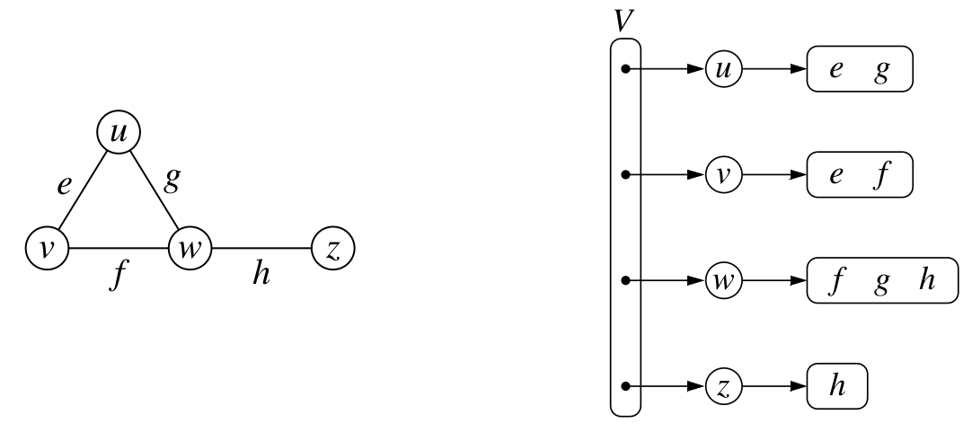
Adjacency List Ex-3
Simple representation of an Adjacency List.

Slide 34
Performance Review
n vertices, m edges
no parallel edges
no self-loops
Bounds are “big-Oh”
Edge List
Adjacency List
Adjacency Matrix
Space
n + m
n + m
n²
incidentEdges(v)
m
deg(v)
n
areAdjacent (v, w)
m
min(deg(v), deg(w))
1
insertVertex(o)
1
1
n²
insertEdge(v, w, o)
1
1
1
removeVertex(v)
m
deg(v)
n²
removeEdge(e)
1
1
1

Slide 35
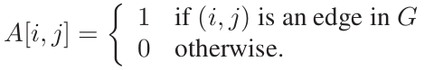
Adjacency Matrix
Graph is represented a two dimensional matrix.
Assume the vertices are numbered from 1,2,...n. Then
the representation is an nxn matrix
A[i,j] th entry is defined as
 | 1 | 2 | 3
1 | 0 | 1 | 0
2 | 1 | 0 | 1
3 | 0 | 1 | 0
a
2
b
a
v
b
1
3
u
w
u | v | w
1 | 2 | 3

Slide 36
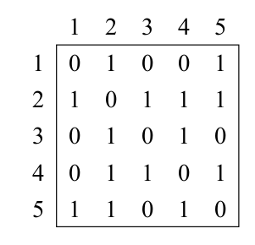
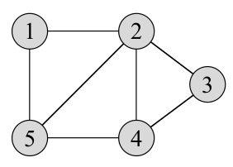
Adjacency Matrix
Graph is represented a two dimensional matrix.
Assume the vertices are numbered from 1,2,...n. Then
the representation is an nxn matrix
A[i,j] th entry is defined as

Slide 37
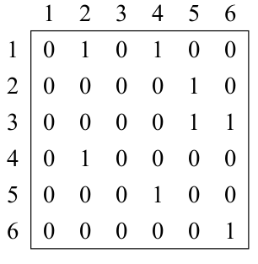
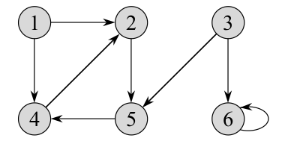
Adjacency Matrix
Graph is represented a two dimensional matrix.
Assume the vertices are numbered from 1,2,...n. Then
the representation is an nxn matrix
A[i,j] th entry is defined as

Slide 38
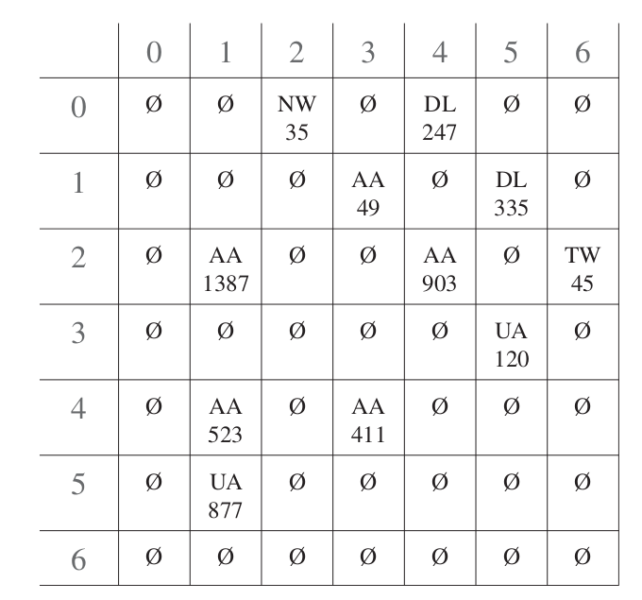
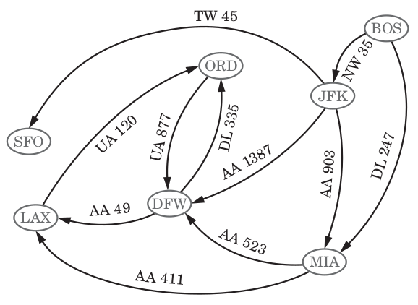
Adjacency Matrix

Slide 39
Adjacency Matrix
Modern Representation
a
v
b
u
w
1
u
2
v
3
w
 | 1 | 2 | 3
1
2
3
a
b

Slide 40
Adjacency Matrix
a
v
b
u
w
1
u
2
v
3
w
 | 1 | 2 | 3
1
2
3
a
b

Slide 41
Adjacency Matrix
a
v
b
u
w
1
u
2
v
3
w
 | 1 | 2 | 3
1 | ∅ |  | ∅
2 |  | ∅
3 | ∅ |  | ∅
a
b

Slide 42
Adjacency Matrix
Given a vertex u & v, presence / absence of edge can be checked in O(1)
Space requirement:
O(n²)
a
v
b
u
w
1
u
2
v
3
w
 | 1 | 2 | 3
1 | ∅ |  | ∅
2 |  | ∅
3 | ∅ |  | ∅
a
b

Slide 43
Adjacency Matrix
Tasks:
Given a vertex, list all adjacent vertices
Given a vertex, list all edges incident on that vertex
a
v
b
u
w
1
u
2
v
3
w
 | 1 | 2 | 3
1 | ∅ |  | ∅
2 |  | ∅
3 | ∅ |  | ∅
a
b

Slide 44
Adjacency Matrix
Deciding to use adjacency matrix representation depends on how dense the graph is.
If the graph has edges close to n², adjacency matrix is preferred
If the graph has edges << n², use a representation saves space [ adjacency list ]
We use adjacency matrix representation to use the mathematical properties of matrix representation.

Slide 45
Performance Review
n vertices, m edges
no parallel edges
no self-loops
Bounds are “big-Oh”
Edge List
Adjacency List
Adjacency Matrix
Space
n + m
n + m
n²
incidentEdges(v)
m
deg(v)
n
areAdjacent (v, w)
m
min(deg(v), deg(w))
1
insertVertex(o)
1
1
n²
insertEdge(v, w, o)
1
1
1
removeVertex(v)
m
deg(v)
n²
removeEdge(e)
1
1
1

Slide 46
#06.3 : DFS & Applications

Slide 47
Terms
A subgraph S of a graph G is a graph such that
The vertices of S are a subset of the vertices of G
The edges of S are a subset of the edges of G
A spanning subgraph of G is a subgraph that contains all the vertices of G
Subgraph
Spanning subgraph

Slide 48
Terms
A subgraph S of a graph G is a graph such that
The vertices of S are a subset of the vertices of G
The edges of S are a subset of the edges of G
A spanning subgraph of G is a subgraph that contains all the vertices of G
Subgraph
Spanning subgraph

Slide 49
Terms
c
A graph is connected if there is a path between every pair of vertices
A connected component of a graph G is a maximal connected subgraph of G
a
d
e
b
Connected graph
c
c
g
a
d
e
a
d
e
f
b
b
h
Non connected graph with two connected components
Non connected graph with two connected components

Slide 50
Terms
A (free) tree is an undirected graph T such that
T is connected
T has no cycles
A forest is an undirected graph without cycles and the connected components of a forest are trees
Tree
Forest

Slide 51
Terms
b
A spanning tree of a connected graph is a spanning subgraph that is a tree
A spanning tree is not unique unless the graph is a tree
Spanning trees have applications to the design of communication networks
A spanning forest of a graph is a spanning subgraph that is a forest
a
d
f
c
Graph
b
a
d
f
c
Spanning tree

Slide 52
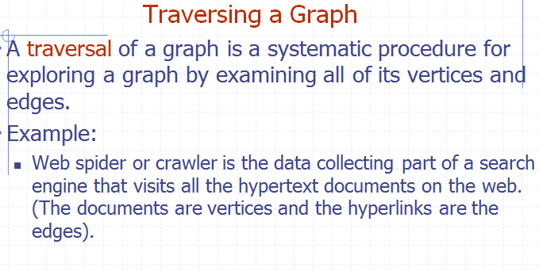

Slide 53
Graph Traversals
Graph traversal is technique used for searching a vertex in a graph. The graph traversal is also used to decide the order of vertices to be visit in the search process. A graph traversal finds the egdes to be used in the search process without creating loops that means using graph traversal we visit all vertices of graph without getting into looping path.
There are two graph traversal techniques and they are as follows...
DFS (Depth First Search)
BFS (Breadth First Search)
DFS (Depth First Search)
DFS traversal of a graph, produces a spanning tree as final result. Spanning Tree is a graph without any loops. We use Stack data structure with maximum size of total number of vertices in the graph to implement DFS traversal of a graph.

Slide 54
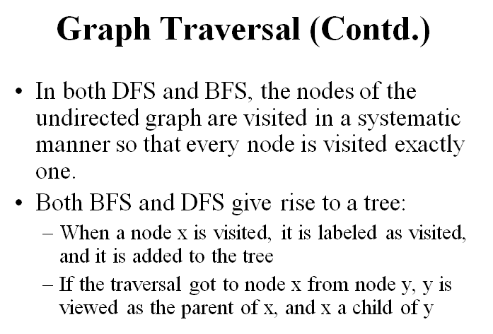

Slide 55
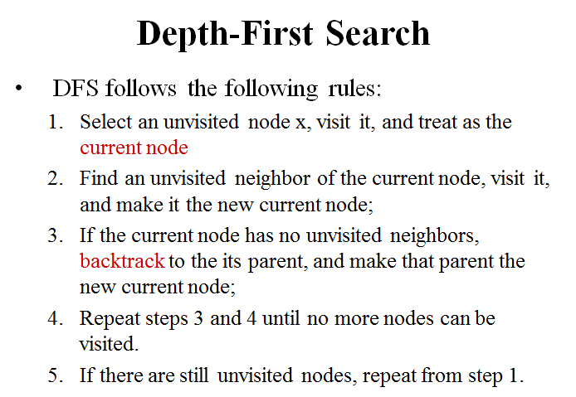

Slide 56
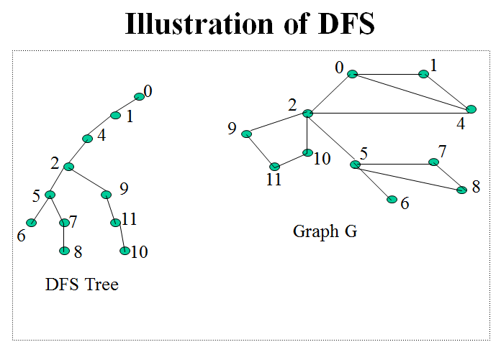

Slide 57
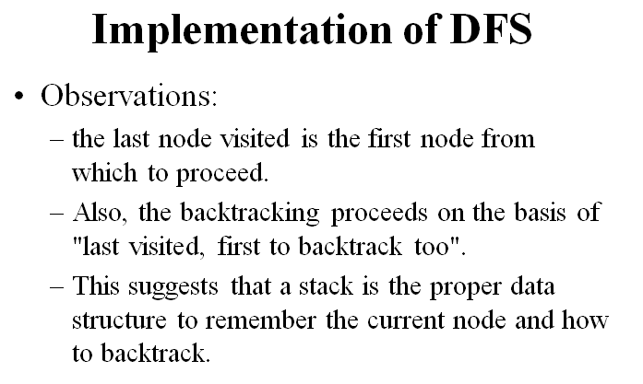

Slide 58
DFS Algorithm - Applications
Let G be a graph with n vertices and m edges represented with the adjacency list structure. A DFS traversal of G can be performed in O(n + m) time. Also, there exist O(n + m) -time algorithms based on DFS for the following problems:
Testing whether G is connected
Computing a spanning forest of G
Computing the connected components of G
Computing a path between two vertices of G , or reporting that no such path exists [ Ex: Good algorithm design exercise. Try and post solution in canvas ]
Computing a cycle in G , or reporting that G has no cycles. [ Ex: Good algorithm design exercise. Try and post solution in canvas ]

Slide 59
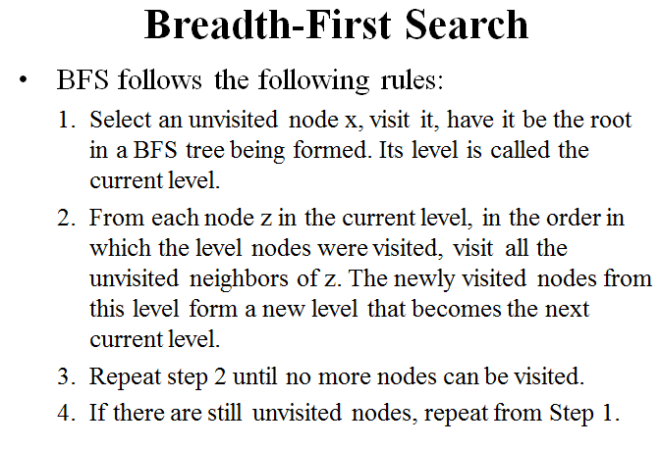

Slide 60
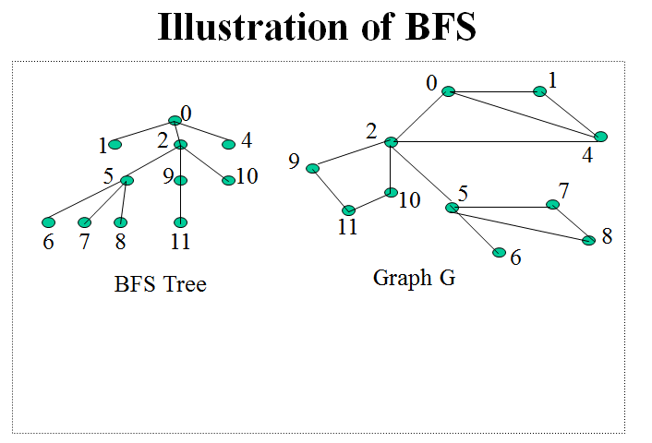

Slide 61
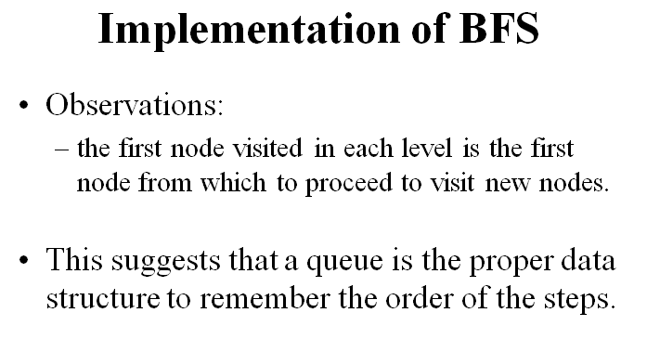

Slide 62
Graph Traversals - DFS
We use the following steps to implement DFS traversal...
Step 1: Define a Stack of size total number of vertices in the graph.
Step 2: Select any vertex as starting point for traversal. Visit that vertex and push it on to the Stack.
Step 3: Visit any one of the adjacent vertex of the vertex which is at top of the stack which is not visited and push it on to the stack.
Step 4: Repeat step 3 until there are no new vertex to be visit from the vertex on top of the stack.
Step 5: When there is no new vertex to be visit then use back tracking and pop one vertex from the stack.
Step 6: Repeat steps 3, 4 and 5 until stack becomes Empty.
Step 7: When stack becomes Empty, then produce final spanning tree by removing unused edges from the graph

Slide 63
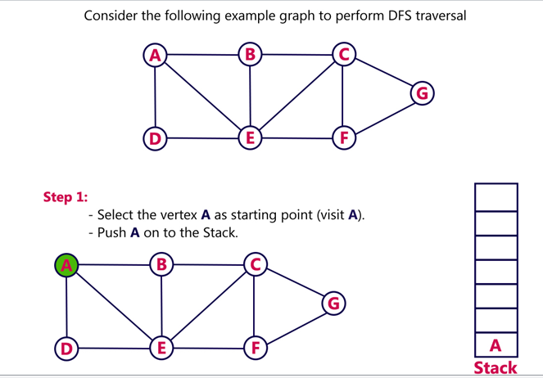

Slide 64
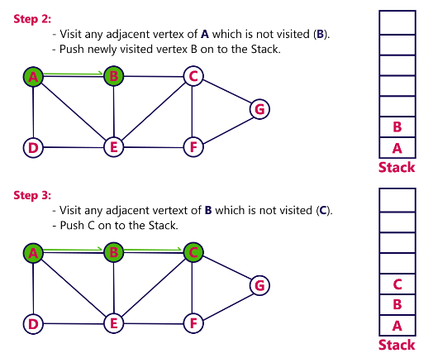

Slide 65
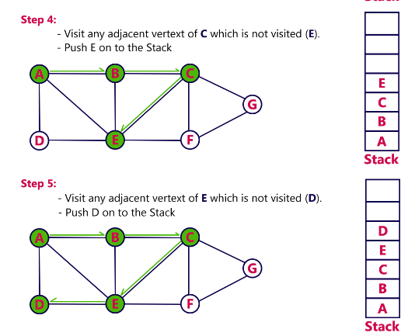

Slide 66
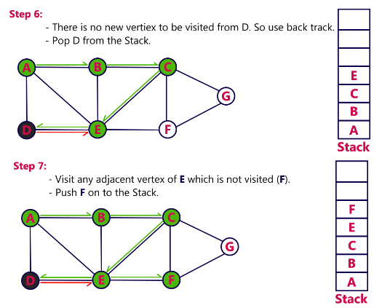

Slide 67
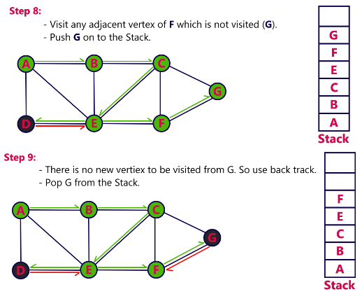

Slide 68
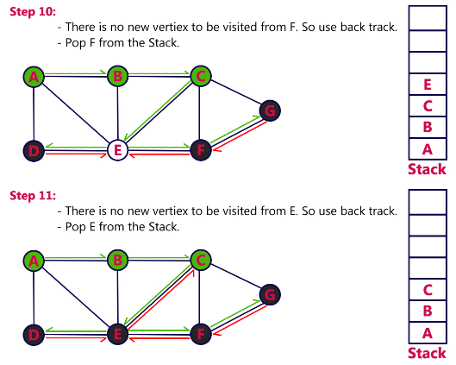

Slide 69
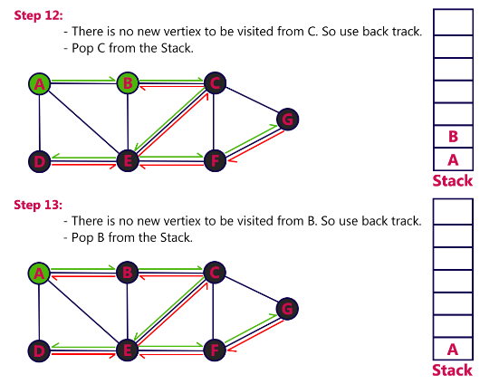

Slide 70
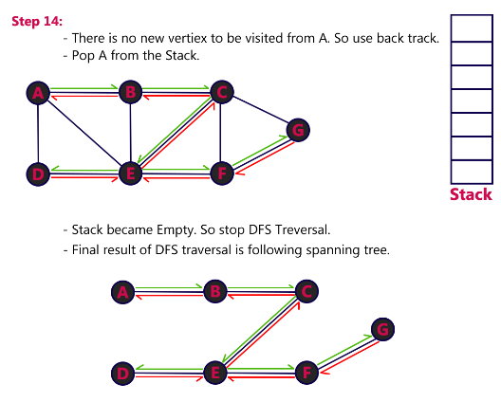

Slide 71
BFS (Breadth First Search)
BFS traversal of a graph, produces a spanning tree as final result. Spanning Tree is a graph without any loops. We use Queue data structure with maximum size of total number of vertices in the graph to implement BFS traversal of a graph. We use the following steps to implement BFS traversal...
Step 1: Define a Queue of size total number of vertices in the graph.
Step 2: Select any vertex as starting point for traversal. Visit that vertex and insert it into the Queue.
Step 3: Visit all the adjacent vertices of the vertex which is at front of the Queue which is not visited and insert them into the Queue.
Step 4: When there is no new vertex to be visit from the vertex at front of the Queue then delete that vertex from the Queue.
Step 5: Repeat step 3 and 4 until queue becomes empty.
Step 6: When queue becomes Empty, then produce final spanning tree by removing unused edges from the graph

Slide 72
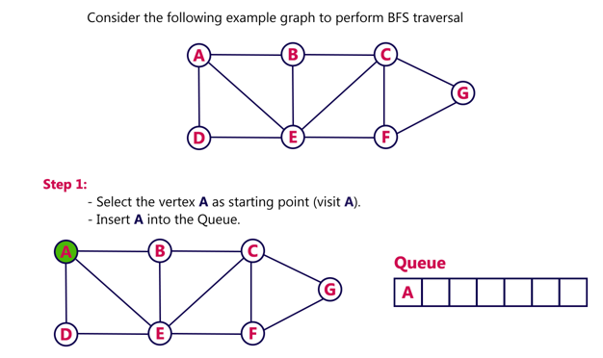

Slide 73
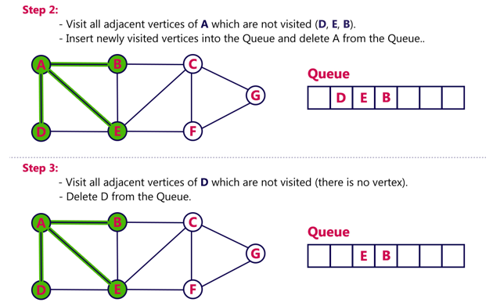

Slide 74
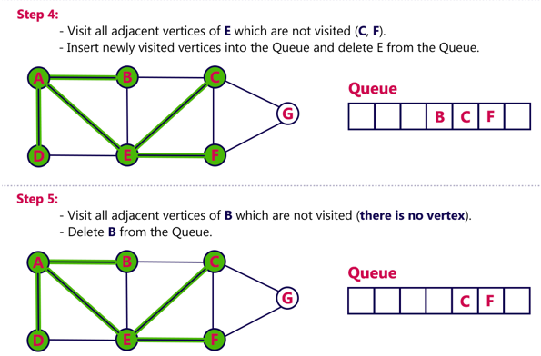

Slide 75
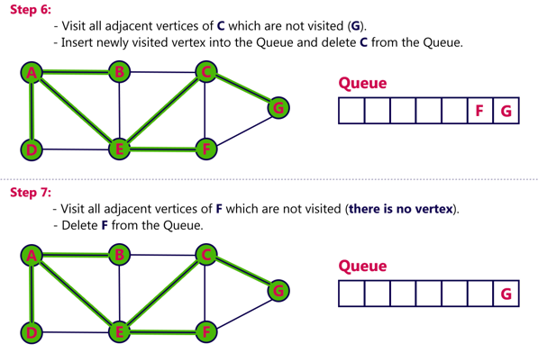

Slide 76
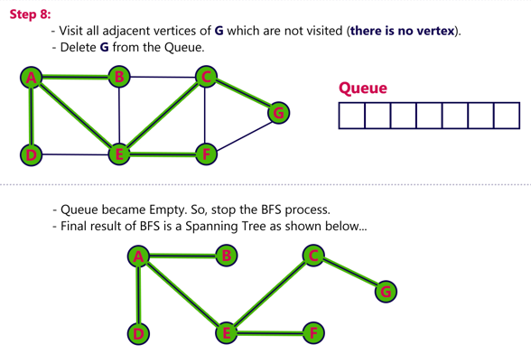

Slide 77
BFS vs. DFS
Applications | DFS | BFS
Spanning forest, connected components, paths, cycles | √ | √
Shortest paths |  | √
Biconnected components [not covered ] | √
L₀
A
A
L₁
B
C
D
B
C
D
L₂
E
F
E
F
DFS
BFS

Slide 78
Depth-First Search
DFS also timestamps each vertex with two timestamps
d[v]: records when v is first discovered and grayed
f[v]: records when v is finished and blackened
Since there is only one discovery event and finishing event for each vertex we have 1≤ d[v] < f[v]≤ 2|V|
Time axis for the color of a vertex
1
2
d[v]
f[v]
2|V|

Slide 79
Depth-First Search
DFS(G)
for each u∈V do
color[u]← white
π[u] ← NIL
time ← 0
for each u∈V do
if color[u] = white then
DFS-VISIT(G, u)
DFS-VISIT(G, u)
color[u]← gray
d[u]← time ← time +1
for each v∈ Adj[u] do
if color[v] = white then
π[v] ← u
DFS-VISIT(G, v)
color[u]← black
f[u]← time ← time +1
Notes:
π[u] ← NIL -→ Making parent of u as nil
π[v] ← u -→ Making parent of v as u

Slide 80
Depth-First Search (Self Study)
Running time: Θ(V+E)
Initialization loop in DFS : Θ(V)
Main loop in DFS: Θ(V) exclusive of time to execute calls to DFS-VISIT
DFS-VISIT is called exactly once for each v∈V since
DFS-VISIT is invoked only on white vertices and
DFS-VISIT(G, u) immediately colors u as gray
For loop of DFS-VISIT(G, u) is executed |Adj[u]| time
Since Σ |Adj[u]| = E, total cost of executing loop of
DFS-VISIT is Θ(E)

Slide 81
Depth-First Search: Example

Slide 82
Depth-First Search: Example

Slide 83
Depth-First Search: Example

Slide 84
Depth-First Search: Example

Slide 85
Depth-First Search: Example

Slide 86
Depth-First Search: Example

Slide 87
Depth-First Search: Example

Slide 88
Depth-First Search: Example

Slide 89
Depth-First Search: Example

Slide 90
Depth-First Search: Example

Slide 91
Depth-First Search: Example

Slide 92
Depth-First Search: Example

Slide 93
Depth-First Search: Example

Slide 94
Depth-First Search: Example

Slide 95
Depth-First Search: Example

Slide 96
Depth-First Search: Example

Slide 97
Depth-First Search: Example

Slide 98
Depth-First Search: Example

Slide 99
Depth-First Search: Example

Slide 100
Depth-First Search: Example

Slide 101
Depth-First Search: Example

Slide 102
Depth-First Search: Example

Slide 103
Depth-First Search: Example

Slide 104
Depth-First Search: Example

Slide 105
Depth-First Search: Example
DFS(G) terminated
Depth-first forest (DFF)

Slide 106
Thank You
Required Reading: Chapter on Graph Algorithms in Text book
106
Notes:
106

